Slide 1

Canteen Management System
Team:
Harsh Agarwal
Prakhar Agarwal
Submitted To:
Prof. Akash Kumar Choudhary

Slide 2

Web
Development

Slide 3

Deploying Website
QOVERY
Qovery helps tech companies to deploy their apps on AWS in just a few seconds. Qovery is the simplest way to deploy your full-stack apps.

Slide 4
Benefits
Configure Backend Fast
Seamlessly Connect Frontend
Use the QOVERY admin UI and CLI's
Use the QOVERY libraries in your web
QOVERY
Deploy in few Clicks
Easily manage content
Use the QOVERY console to host static websites and single page web apps with a Git-based workflow
Use the QOVERY admin UI to provide non-developers with administrative access

Slide 5
INTRODUCTION
This is a Canteen Management System. We have used Html,CSS, Javascript and Nodejs(for making the routes). We have used MongoDB Database. The OOPS concepts have been implemented in Javascript Language. The project has the following functionality:-
User
The user can register, login and place an order and delete those orders whose status is not accepted.
An E-Wallet has been introduced and the customer can add money to it using their debit or credit card. This money can then be used to place orders.
A new feature that we have added is that the user can purchase a Premium Subscription and his/her order will have a higher priority as compared to users who do not a Premium Subscription.
Another feature which has been introduced is that a User with Premium Subscription can pre book order for any time of the day.
Admin
Can view the details of the users.
Can see the details of Premium and Non Premium users.
Can cancel Premium Subscription of a user after the expiry date.
Can see the list of orders which were placed on a particular date and can accept the order by clicking on deliver.
Can add or remove food items from the menu.

Slide 6
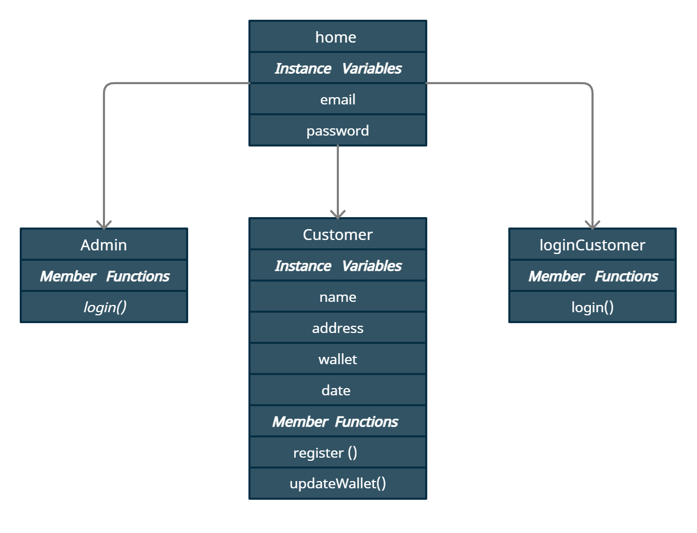
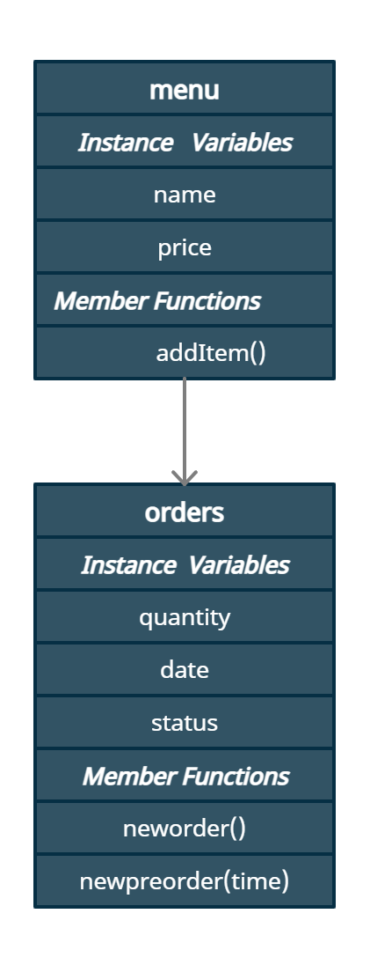
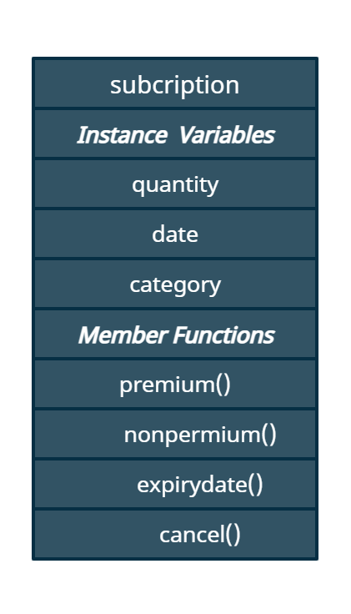
We have implemented following Classes
Here home is the base class for three classes Admin , Customer and loginCustomer
Class menu is superclass for orders
Subscription is separate class and no class is inherited from it

Slide 7
DFD

Slide 8
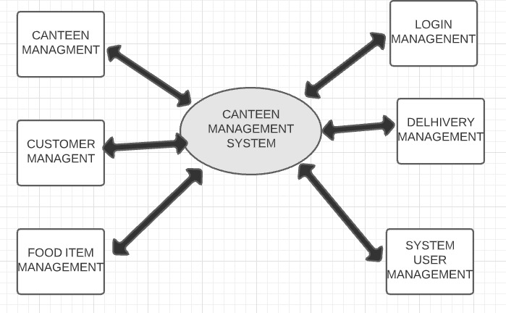
0 Level DFD

Slide 9
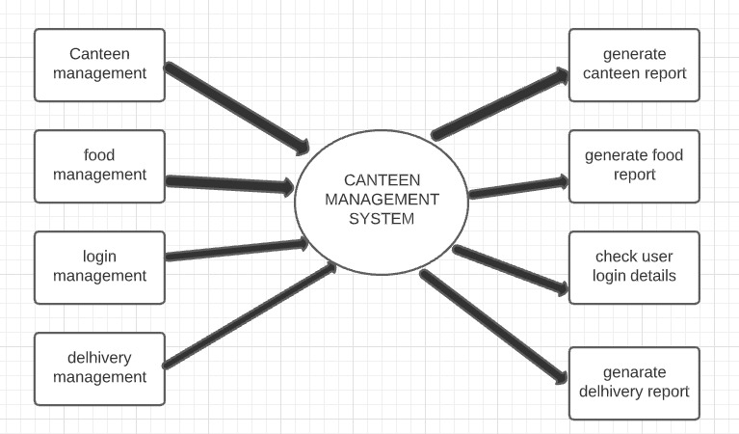
1 Level DFD

Slide 10
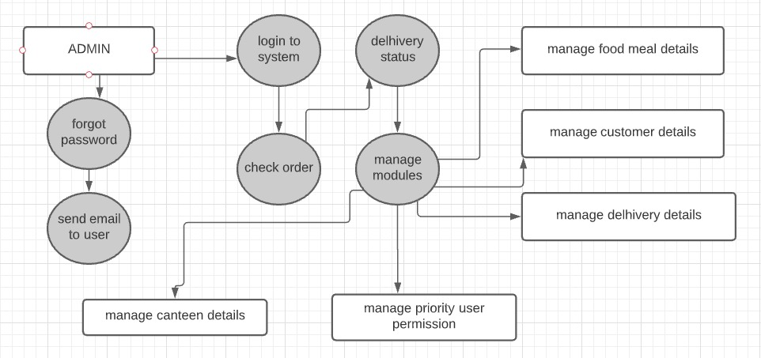
2 Level DFD

Slide 11
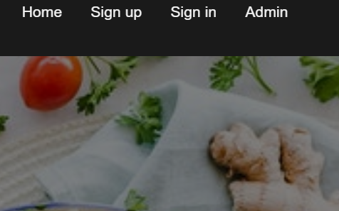
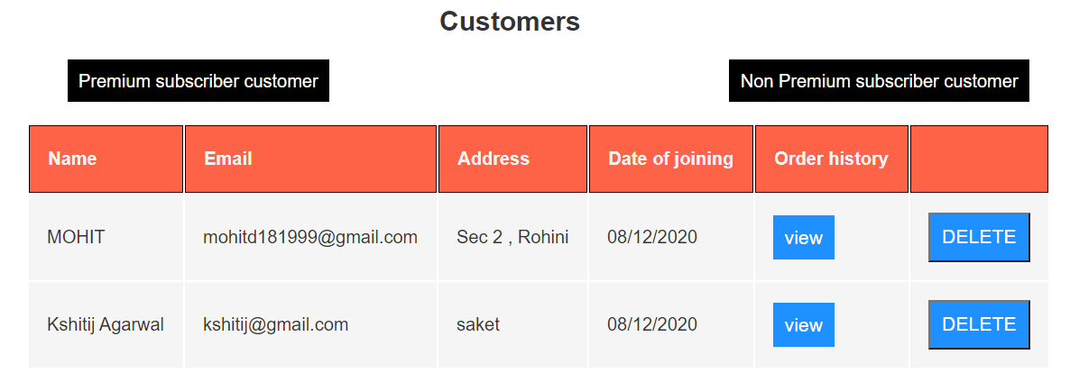
Pictures of the Various Functionalities
SignUp, SignIn options for Admin and Customers
Details of Customers and Options to separate customers with and without Subscription

Slide 12
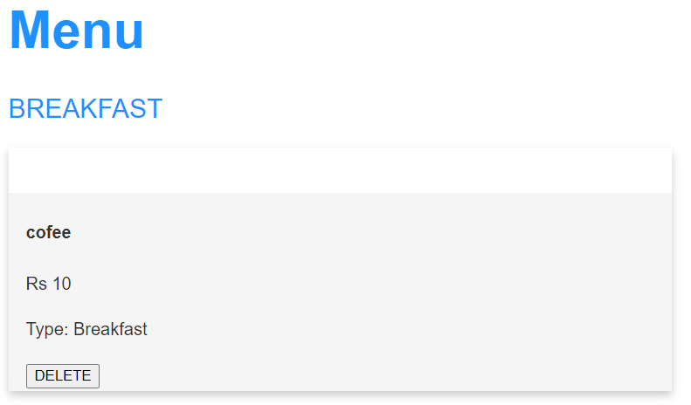
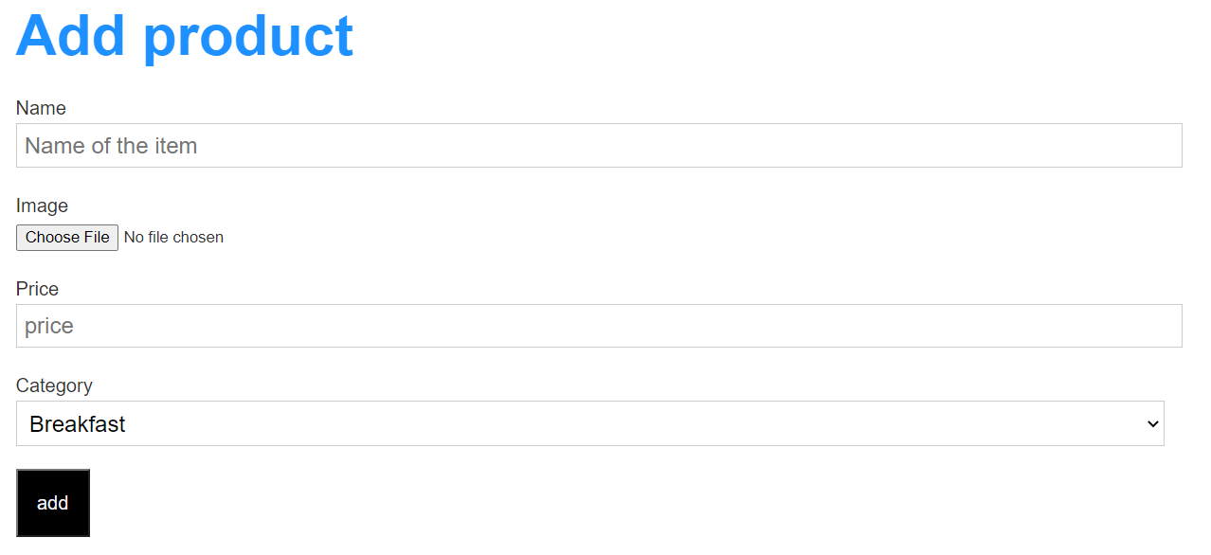
Feature to delete items from menu
Feature to add items to the Menu

Slide 13
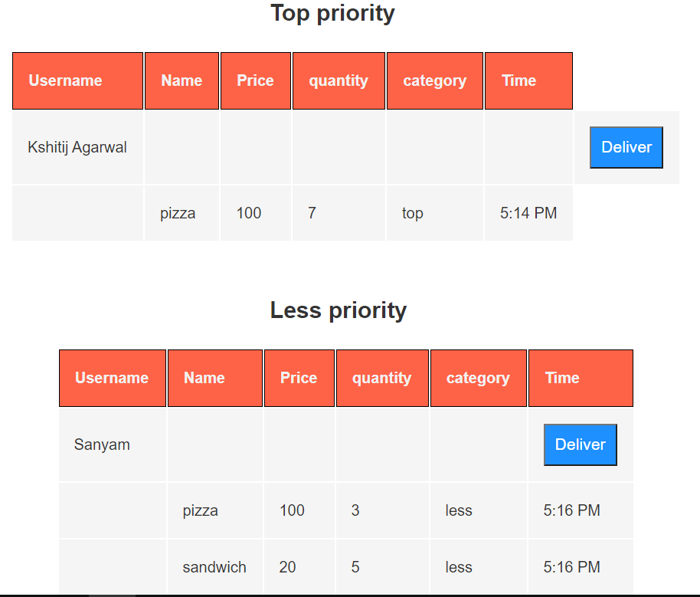
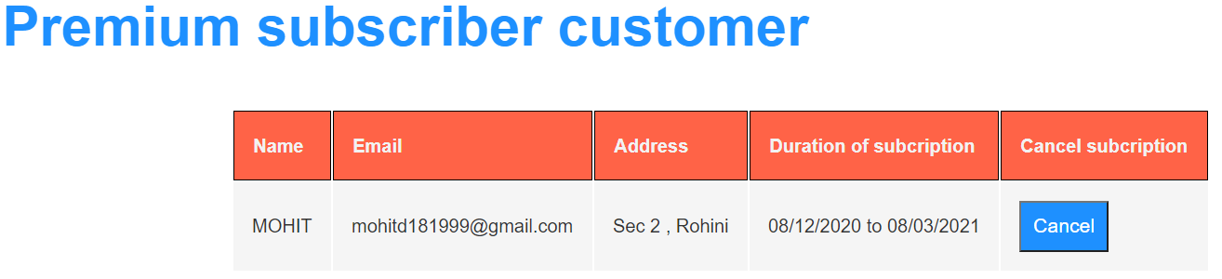
Feature to assign priorities to orders and accept the order by clicking on deliver
Feature to Cancel Premium Subscription

Slide 14
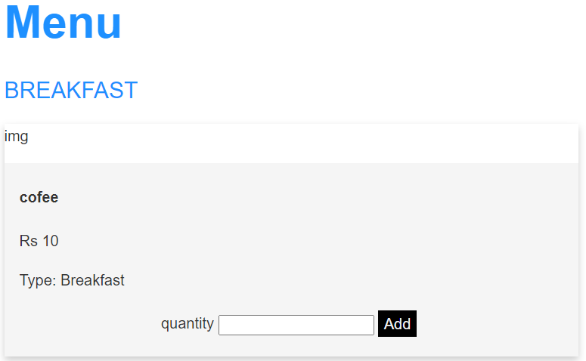
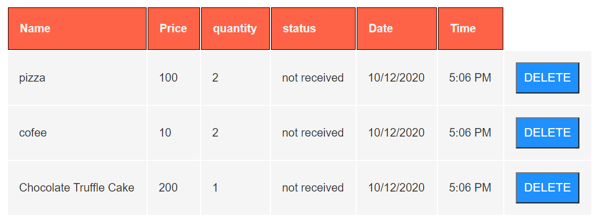
Customers can Place Orders
Ability to views orders placed and also cancel them using delete option

Slide 15
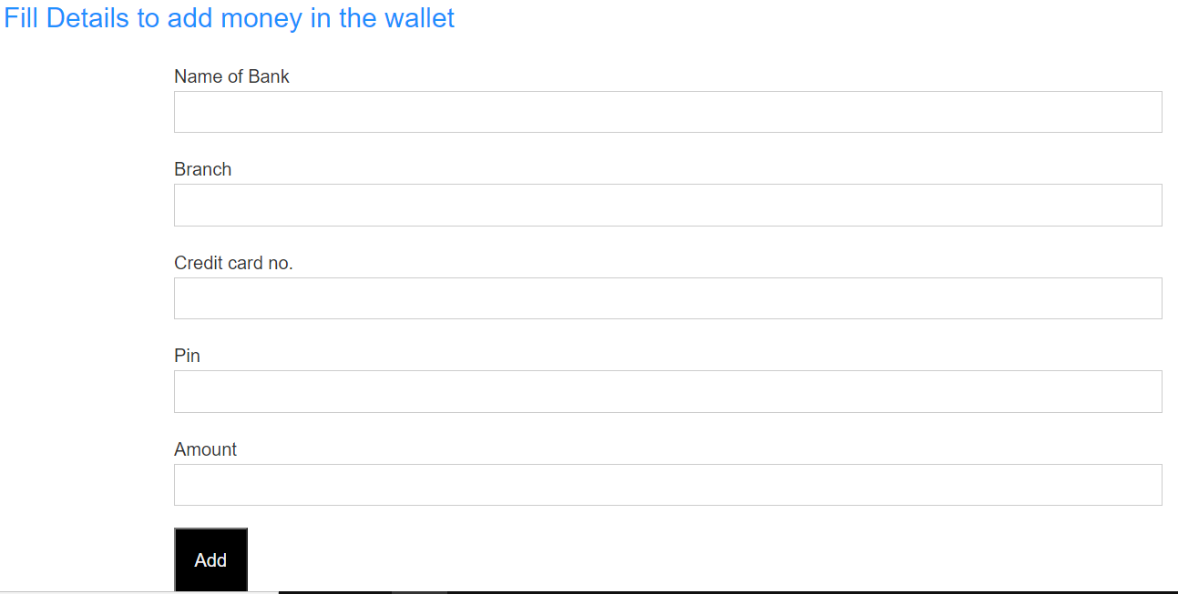
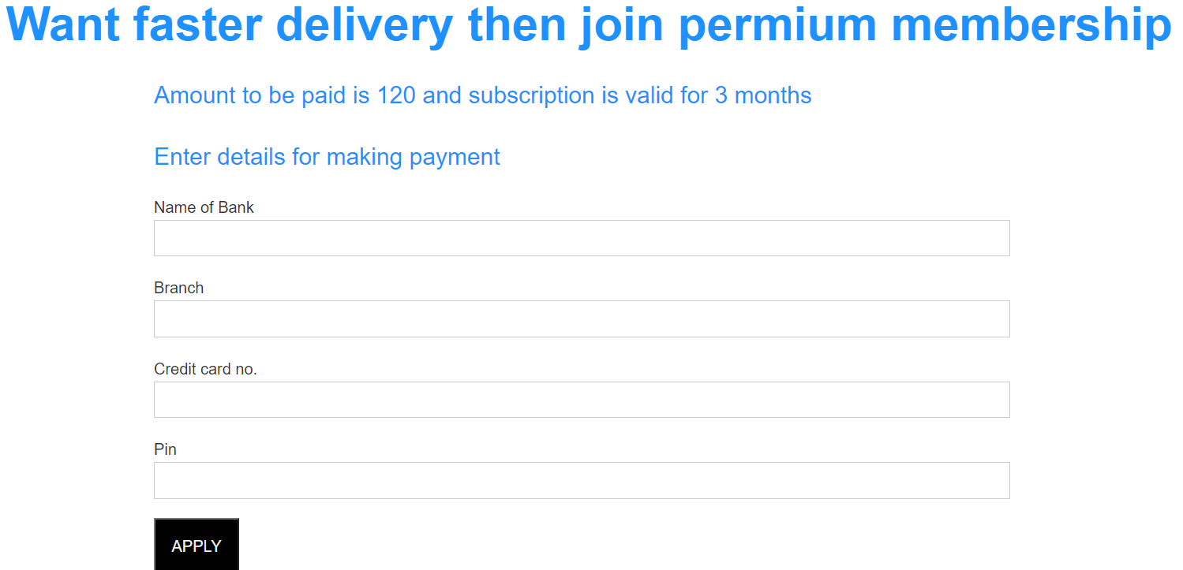
Customers can add Money in E- Wallet
Premium Memberships!!

Slide 16
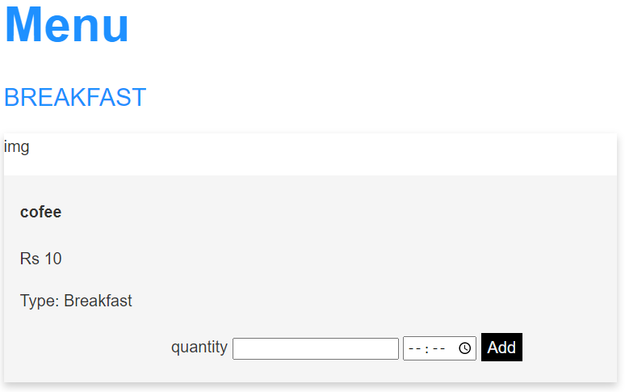
Customers can pre-place their orders

Slide 17
Steps to run the project
Open the project and type nodemon server.js or node server.js in the terminal.
After successfully running the above command open browser and type
http://localhost:4341/
And project will be running.
OR
Open your Web browser and type https://main-online--hi060ej25v2vkuak-gtw.qovery.io/
Project will be running successfully on your machine

